Slide 1

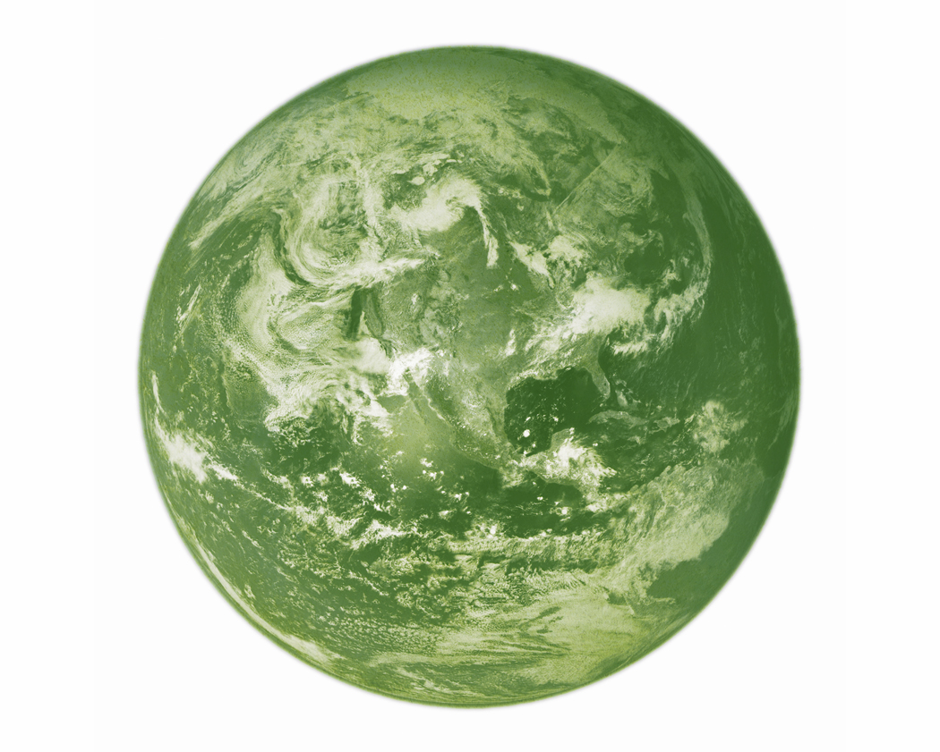
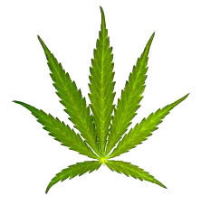
One Plant Can Save This Earth
Notes:
Good Morning… sustainable development focus on cannabis Hemp
Cannabis Hemp is the missing piece in the puzzle of ENVironmental and ECOnomic sustainability

Slide 2
Cannabis Hemp
Can replace
  petrochemicals (by extension, plastics)
  Wood
  Pharmaceuticals to some extent
  Cotton
nutritious food source for humans and animals
agricultural implement
Notes:
In fact as long as its not glass or metal, it can be made with hemp
…in every case the resulting product is superior to its environmentally devastating counterpart.

Slide 3
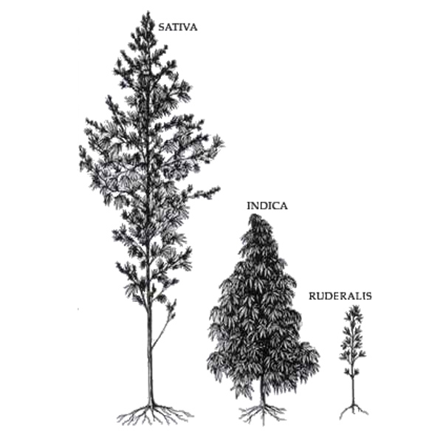
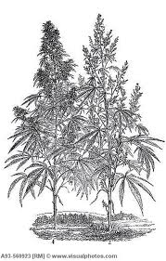
What is Hemp?
3 different varieties or cultivars
Cannabis Sativa L.
dioecious annual
Notes:
Hemp is the strongest most robust natural fibre known to man and a cholesterol lowering full source of protein and essential fatty acids.
Cannabis Sativa L. is a family of plants producing cannabinoids
Hemp is grown for stalk or seed. Cultivation methods for each are different.
Its dioecious so if grown for seed there must be both male and female present
The THC maximum limit for hemp is a legal artifice that serves no other purpose but to dissuade and hinder hemp industries. It was previously 0.8% in most places including the EU until french breeders developed seed at 0.3 and persuaded lowering the limit to control eu market

Slide 4
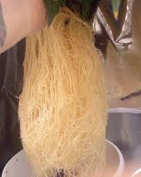
Roots
Long Thick Extensive Root System
  Prevention of Soil Erosion
    Aerate
    Bind
  Phytoremediation
  Nutrient Rich (act as fertilizer)
  Medicinal
Notes:
This plant has a taproot of indefinite length, & feeder roots can grow to 3ft easily…
SOIL MOP Chernobyl
Benlate…. Mr Williams… DuPont im sure! 1972 EPA forced warning and 2001 discontinued – cirhossis & anopthalmia
Removes Metals, Pesticides, Solvents, Explosives, Crude Oil

Slide 5
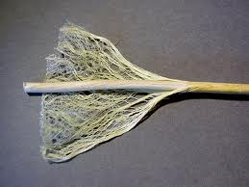
Outer Stem Fibers
Thread-like, Long Bast Fibers 2 to 3 ft long
  spun into threads, further into rope
  Textiles, ranging from carpet backing and sails to fine linens… etc
  Can produce superior strength lightweight composites
  Ethanol
Notes:
Fine linens + steam application causes fibres to fibrolate,
No more difficult than working with fiberglass
can make a 2 x 4 post or the body of a stealth bomber!

Slide 6

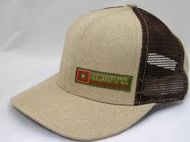
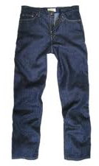
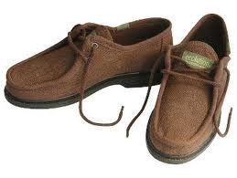
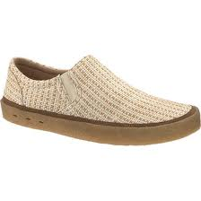
Made of Hemp
Notes:
Hemp can be processed in a primitive way or using the newest tech avail like cottonizing
The oldest relic of human industry… Hemp fabric
Hemp fabrics don’t weaken, they soften the more you wash them
Pure hemp clothing is quality you can pass onto your grandchildren

Slide 7


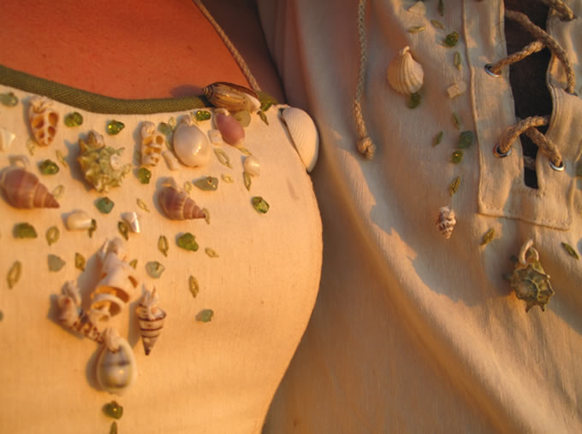
A Hemp Wedding
Notes:
This is beautiful hemp dress with shells and we could do this in St Lucia

Slide 8
Inner Stem / Core
Woody fiber, hurds & pulp (77% cellulose)
  Paper, packing material, fiberboard
    4X more productive than trees per acre
    Hemp does not require sulphur based acids, dioxins and 2000 toxic chlorinated organic compounds to be made into paper
    Hemp paper can be recycled many more times
    Hemp paper won’t turn yellow, resistant to insects & mildew
  SUSTAINABLE (6 months vs. 150 years)
Notes:
C6 H10 06
Cellulose is the building block of modern industry
Hemp is the highest producer of cellulose with lowest lignin

Slide 9
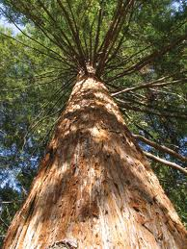
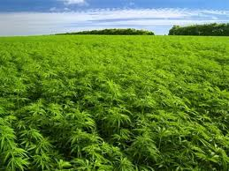
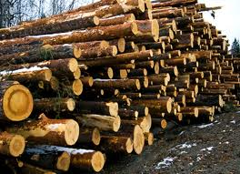
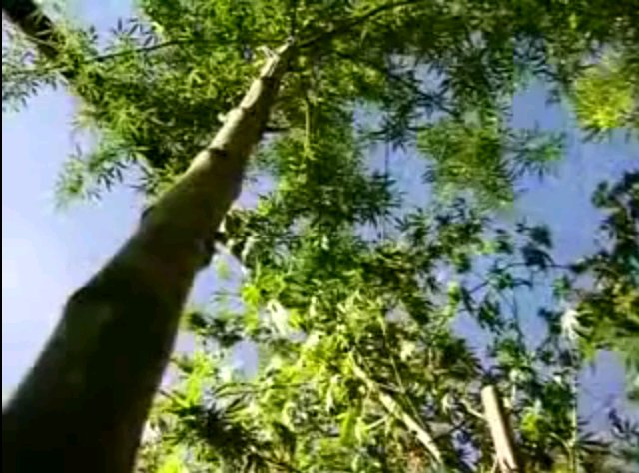
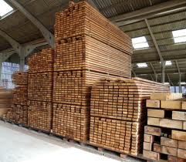
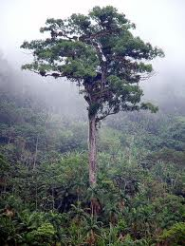
SUSTAINABLE
Vs.
Hemp,
77% cellulose
Growth period: 6 months
Yield: 3-8 tons per acre
Trees,
80 – 400 yrs
Notes:
Hemp high cellulose low lignin
Trees high lignin lower cellulose

Slide 10
Plastics…
Disposable
Notes:
Litter? Pick up others?
Its pure insanity to make items for 5 mins use out of plastic lasting 500 years

Slide 11
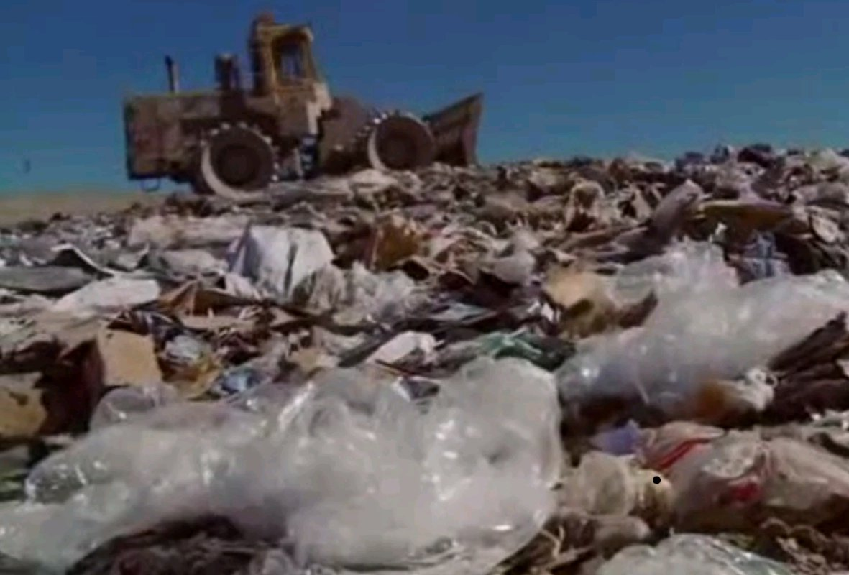
There is NO PROPER Disposal
Notes:
Pacific Vortex
We are NOT living sustainably. We are orchestrating our own extinction
Borrow from Dr Jules… What we do now about what we inherited yesterday must
give answers for today and lay the foundation for tomorrow

Slide 12
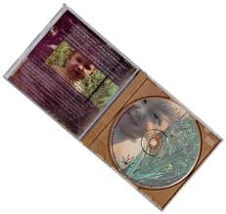
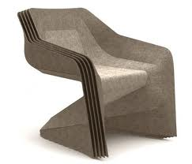
Cellulosic Plastics
Bio-synergistic
  Disposable Packaging
  Can degrade into fertiliser in as little as 2 years
  Safe for food and human health
  Can create everything from cellophane to dynomite
  Rayon, Nylon etc
Notes:
Little bit of chemistry

Slide 13
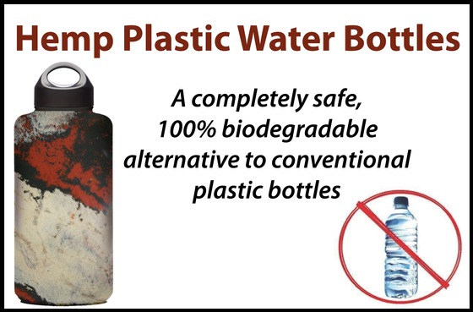
JD Leadham, High School Student

Slide 14
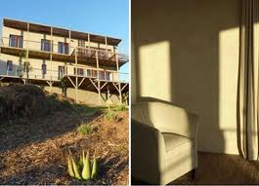
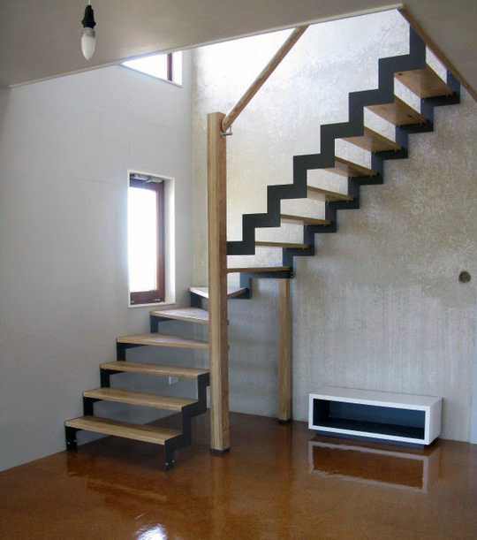
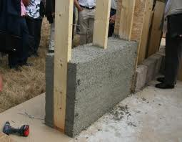
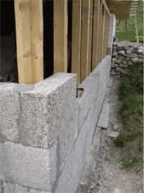
Construction
Concrete (Hurds, Lime, Water)
  Block or form pack method (refined or un)
  Lowest cost & highest quality
  Grow a house on 2 acres
  Build
Notes:
Can start this now. All technonlgy is here now.
A 2 storey concrete regular size family home would cost lucians perhaps 5000 instead of 500,000
Buildings bridges highways culverts sidewalks

Slide 15
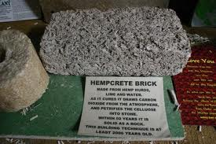
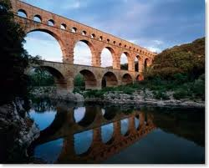
Construction
Hempcrete Advantages
  Stronger in earthquakes & hurricanes
  Anti-mildew, hypoallergenic, anti-termite, anti-rodent and pest, fire resistant & sound proof
  Lower heating and cooling costs
Dordogne, France
Notes:
Last budget.
How much would we save on buildings highways bridges and sidewalks?
Culverts…
How many sidewalks could we have that we couoldnt otherwise!
How would this NOT be good?

Slide 16
Compressed Agricultural Fiber
High Pressure Composites
  Plywood
  Countertop Surfaces
  Industrial Fabrication Materials
  Construction Materials
For stronger composites, apply heat
Relatively easy to work with
Notes:
Hurds + natural resin or binding agent and high pressure. For stronger composite apply heat.

Slide 17
All plants can make Biofuel
But high cellulose plants work best
  Biomass Fuel
    Gas
    Charcoal
    Methanol
    Gasoline
    Electricity
  Non Toxic Paints & Sealants
Notes:
All plants store solar energy therefore can be fermented to produce ethanol
But high cellulose works best
Plants provide O for combustion, emissions will be CO2 and water (called closed cycle) both reabsorbed by plants
Can be undertaken small or large scale

Slide 18
Automobile Industry
A vehicle body, chassis, upholstery, plastic parts, safety glass, lubrication and fuel can be made from hemp
    1000 lbs lighter translates to better gas mileage
    10 X stronger – won’t dent
    Rudolph Diesel’s engine was designed to run on biomass fuel in 1896
    Henry Ford’s first automobile was constructed of hemp and designed to run on alcohol from biomass in 1929*
1896……1929………………still can’t?
Notes:
116 yrs ago or 119
Adding 10% ethanol lowers emissions 25-30%
15% mix 40% low CO and 50% less smoke
Vehicle fueled on ethanol drive 35,000 miles no carbon deposit in engine or exhaust
Ethanol & methanol from biomass provide higher octane and less CO
Jamaica oxygenates with sugarcane ethanol?

Slide 19
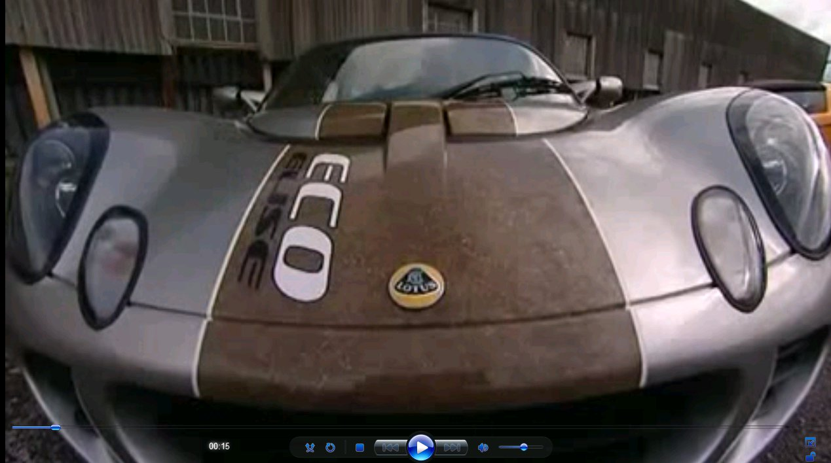
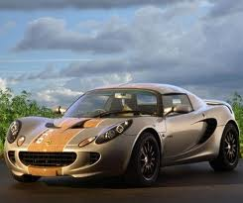
UK 2012 Ford Eco Elise

Slide 20
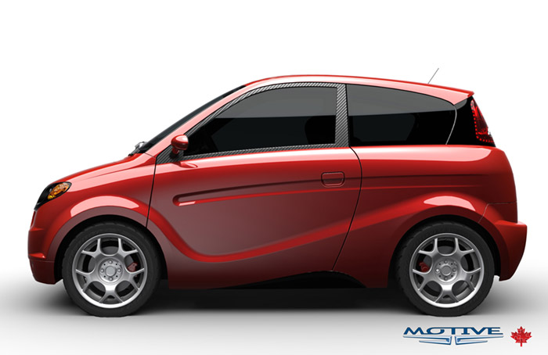
Canada Kestrel Hemp Electric Car
Notes:
Can solar charge this one

Slide 21
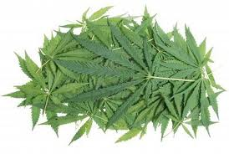
Foliage
Rich in Nitrogen.
Medicinal
When returned to the soil along with the roots, they replace most of the fertilizing elements used during the growing season.
Farmers have reported excellent yields on lands cultivated steadily for more than 100 years

Slide 22
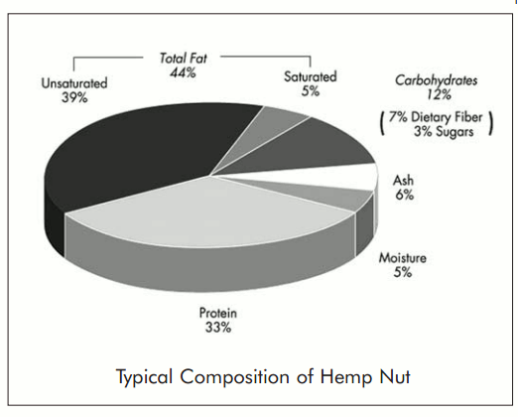
Seed
20 amino acids plus phytonutrients, the disease-protective element of plants with benefits protecting your immunity, bloodstream, tissues, cells, skin, organs and mitochondria.
Notes:
Oil can be used as food or fuel and compatible with current distillery equip. is Lubricating oil
Lowest in sat fats, colesterol lowering
hemp oil highest in total essential poly un sat fatty acids at 81%
3:1 ratio
All 20 amino acids, including the 9 essential amino acids (EAAs) our bodies cannot produce.
could aid, if not heal, immune deficiency diseases. has been used to treat nutritional
deficiencies brought on by tuberculosis
* A perfect 3:1 ratio of Omega-6 Linoleic Acid and Omega-3 Linolenic Acid – for cardiovascular health and general strengthening of the immune system.
* A superior vegetarian source of protein considered easily digestible.
* A rich source of phytonutrients, the disease-protective element of plants with benefits protecting your immunity, bloodstream, tissues, cells, skin, organs and mitochondria.
* The richest known source of polyunsaturated essential fatty acids.

Slide 23
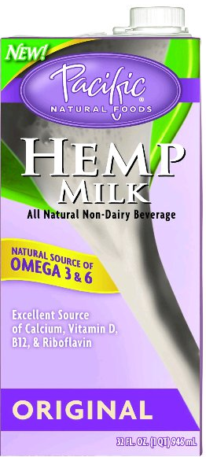
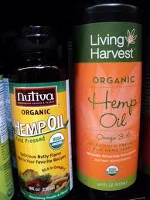
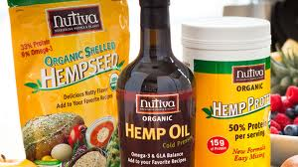
Seed
For food…
oil, milk, cheese, butter, ice cream, flour, breads, cakes

Slide 24
Seed
Waste material (crushed seed) from oil extraction is an excellent feed stock
Cattle they gain more weight than those on conventional feed
Layers gain weight egg production increases and no need for additional antibiotics
Recent scarcity of hemp has been blamed for the decline of certain wild bird populations
Notes:
Trash to treasure

Slide 25
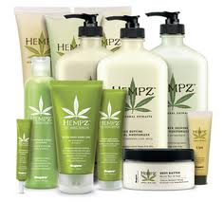
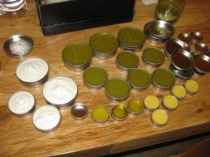
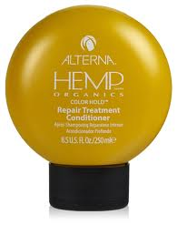
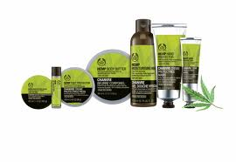
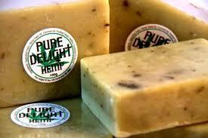
Hemp Oil Body Care Products
Notes:
Shampoos, hair cream, gel, skin cream, ointment, massage oil, moisturizer etc

Slide 26
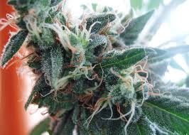
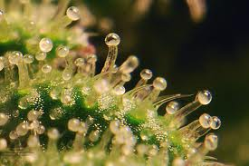
Flower Tops / Buds
Notes:
The flower tops are where cannabinoids are concentrated.
Brownies, smoking, oils rubs, raw juice… Vaporizer eliminates risks posed by smoking
This is the part that will get you high if there is . This part of the female is ganja or marijuana

Slide 27
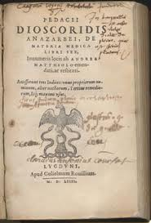
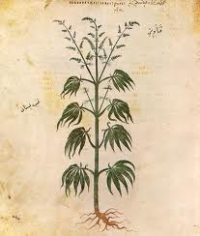
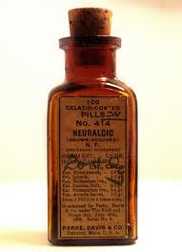
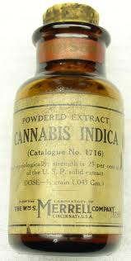
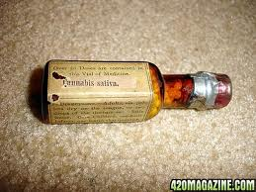
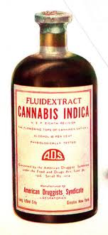
Traditional Medicine Since 16th Century BC
It is interesting to note that Cannabis and THC are responsible for the understanding of a great deal about the endogenous compounds of the human body and brain
Notes:
Anandamide and 2AG (ad-glycerol)
Existing evidence proves that it has been used as a medicine since 16th century BC.
Dioscorides materia medica and plenty others including over 600 the US Pharmacopea from 1869
until it was suddenly and covertly banned via name changing (MARIJUANA)
by RF’s puppet FDR, in Aug 1937 via a non existent tax stamp…
and later the DEA schedule of controlled substances
As if that isnt bad enough… remember the hippies?
1971 commission found it harmless… so nixon did the only logical thing… he dissolved NDA formed DEA
Wrote up a

Slide 28
LD50
To achieve LD50 with Cannabis you must consume 15,000 lbs in 15 minutes.
Have you ever wondered why a plant that has been referred to as
one of the safest therapeutically active substances known to man…
Is ILLEGAL ???
Notes:
Heavy smokers of cannabis have lower incidences of cancers than the general population
Including those who have never smoked anything at all
Concern about the LIE… and what else youths will reject as true.

Slide 29
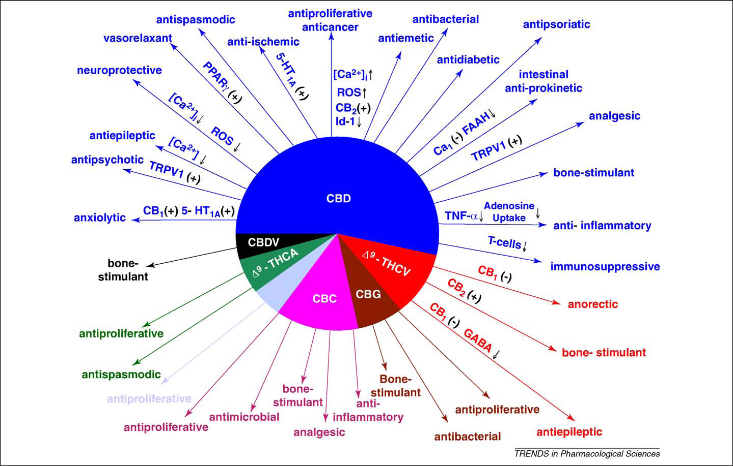
Cannabinoid Science
Notes:
We NOW know that endocannabinoids are essential
and insufficient levels cause a whole host of problems (eg. rimonabant)
Grows brain cells and protects neurons….
CB1 – movement, memory processing, and pain modulation
Few in brain stem which may account for the lack of cannabis related acute fatalities.
CB2 – mainly in immune cells… controls inflamation… no psychological effects
9Thc binds to cb1 at 41nm strongest agonist
8thc to cb1 at 126nm
Cbg and cbd have low affinity to cb1’s cbd to cb1 at 4350nm antagonist

Slide 30
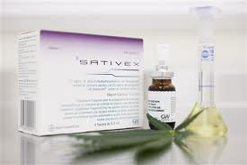

GW Pharmaceuticals: Sativex
Securing Monopolies
Notes:
6630507
It appears pale people have rationalized them selves into another monopoly
Using false concerns over smoke and euphoria and lack of labeling as justification.

Slide 31






Some Legal Plants
Notes:
Manchineel, Castor Oil, Soya Bean (Tripsin), Bitter Casava, Oleander.

Slide 32

We’ve been Hoodwinked!
Notes:
Repression and control

Slide 33
Anonymous
When an honest man discovers that he is mistaken,
he either ceases to be mistaken,
or he ceases to be honest.

Slide 34


